Slide 1


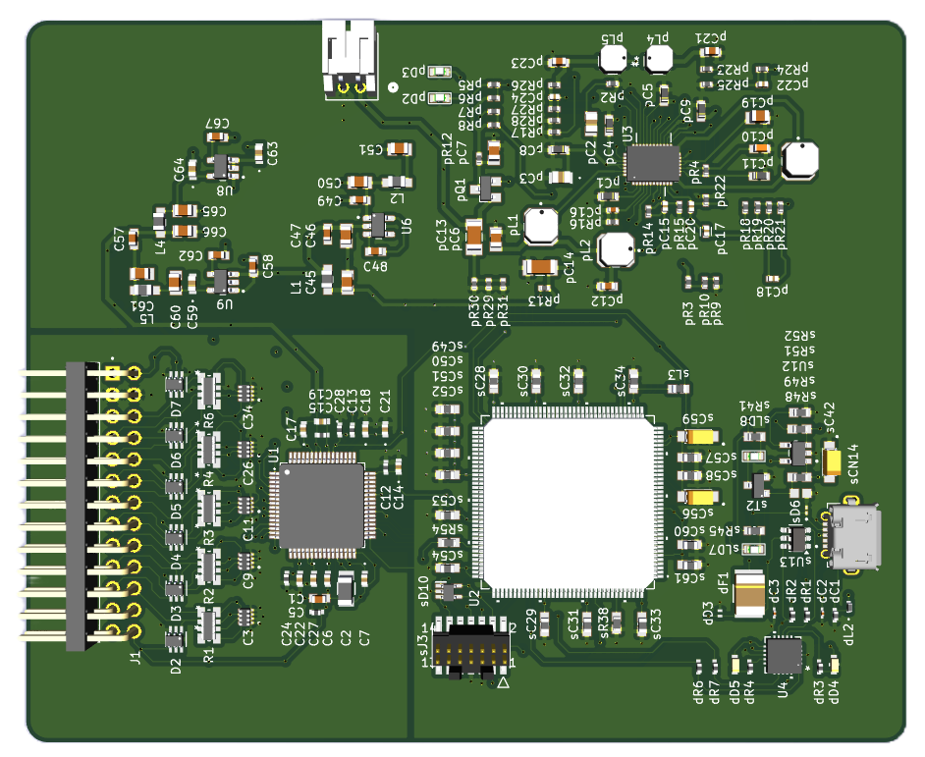
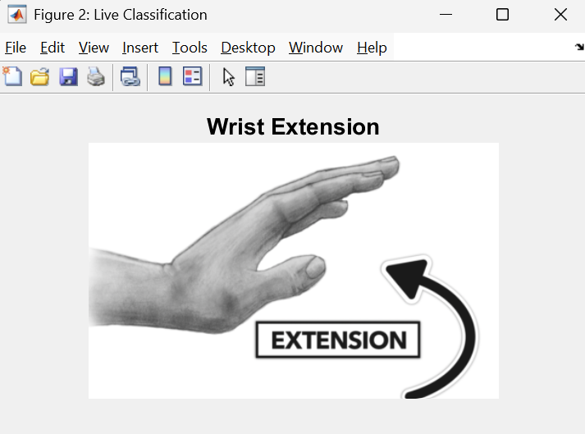
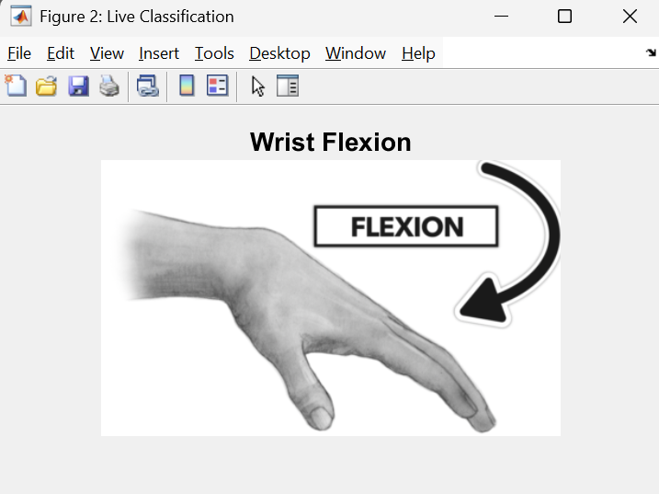
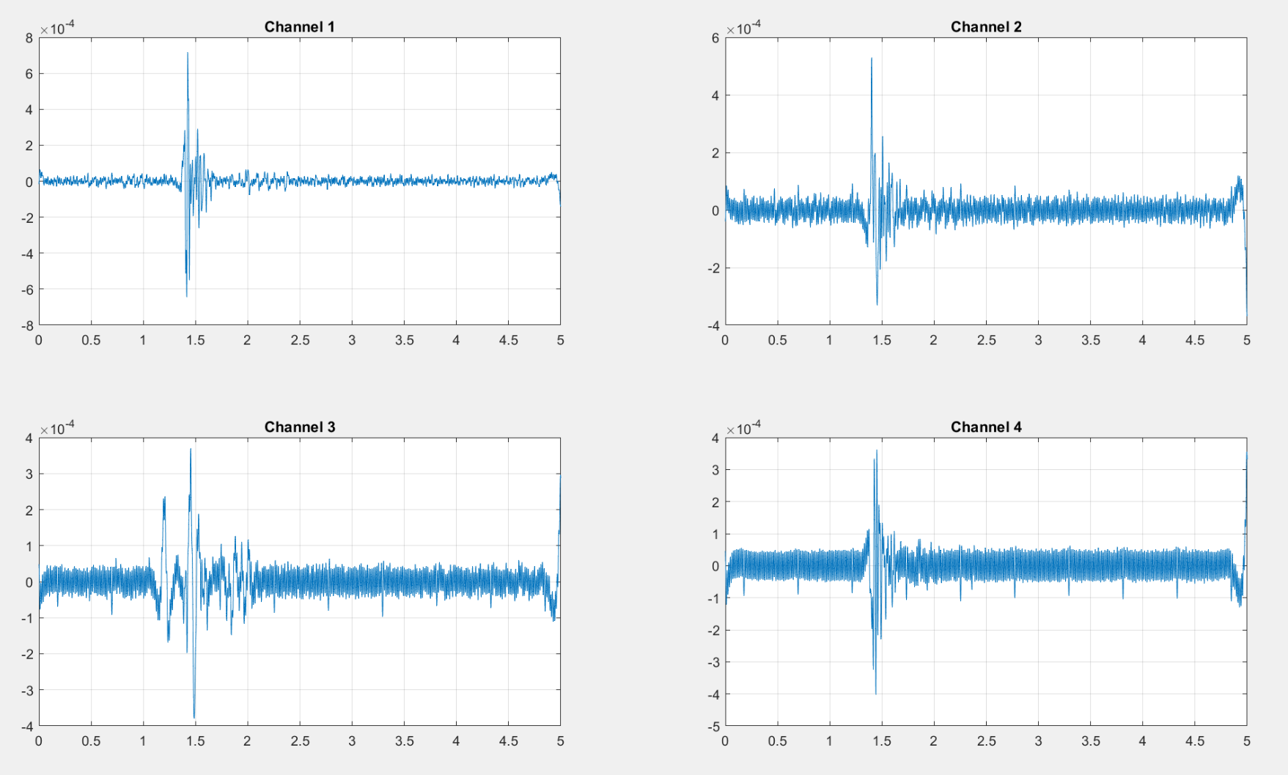
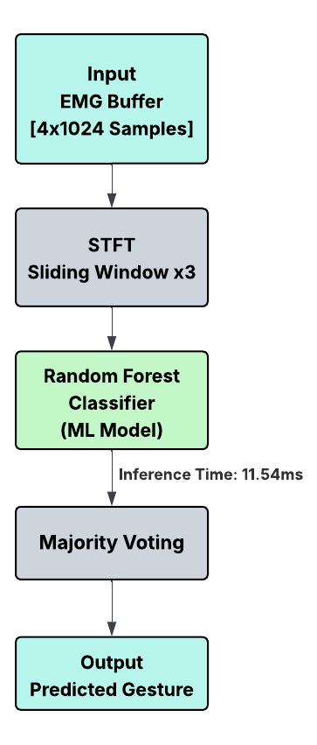
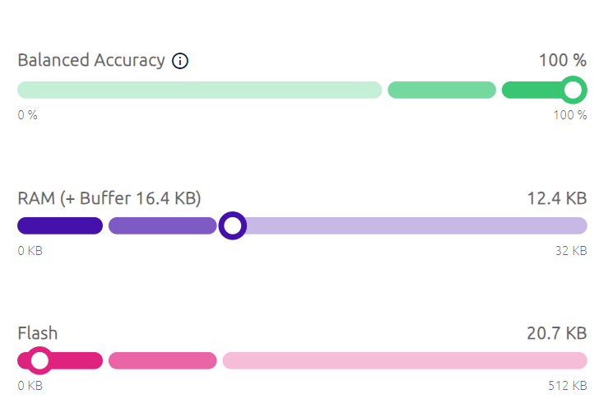

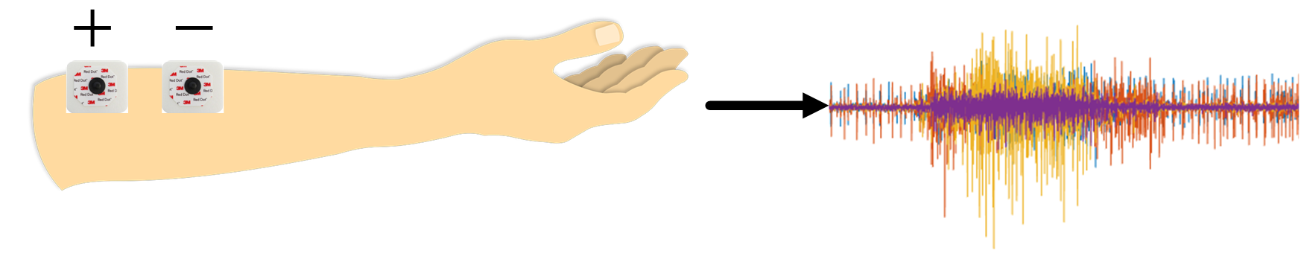
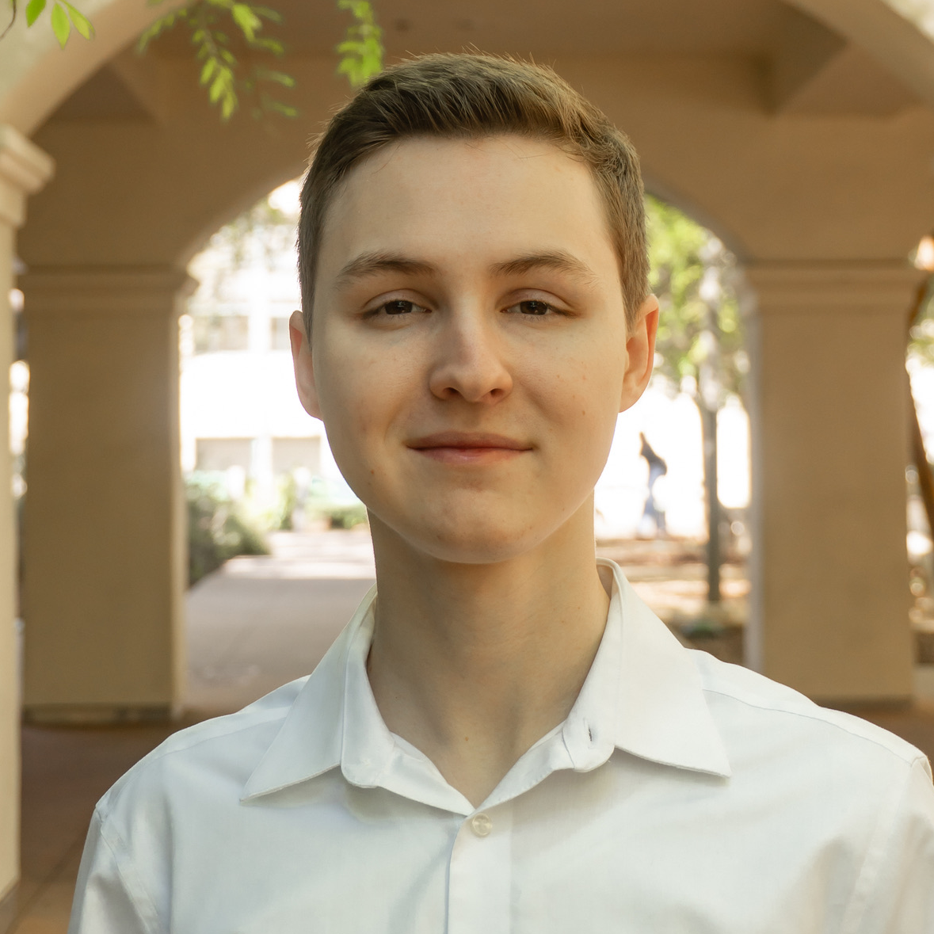
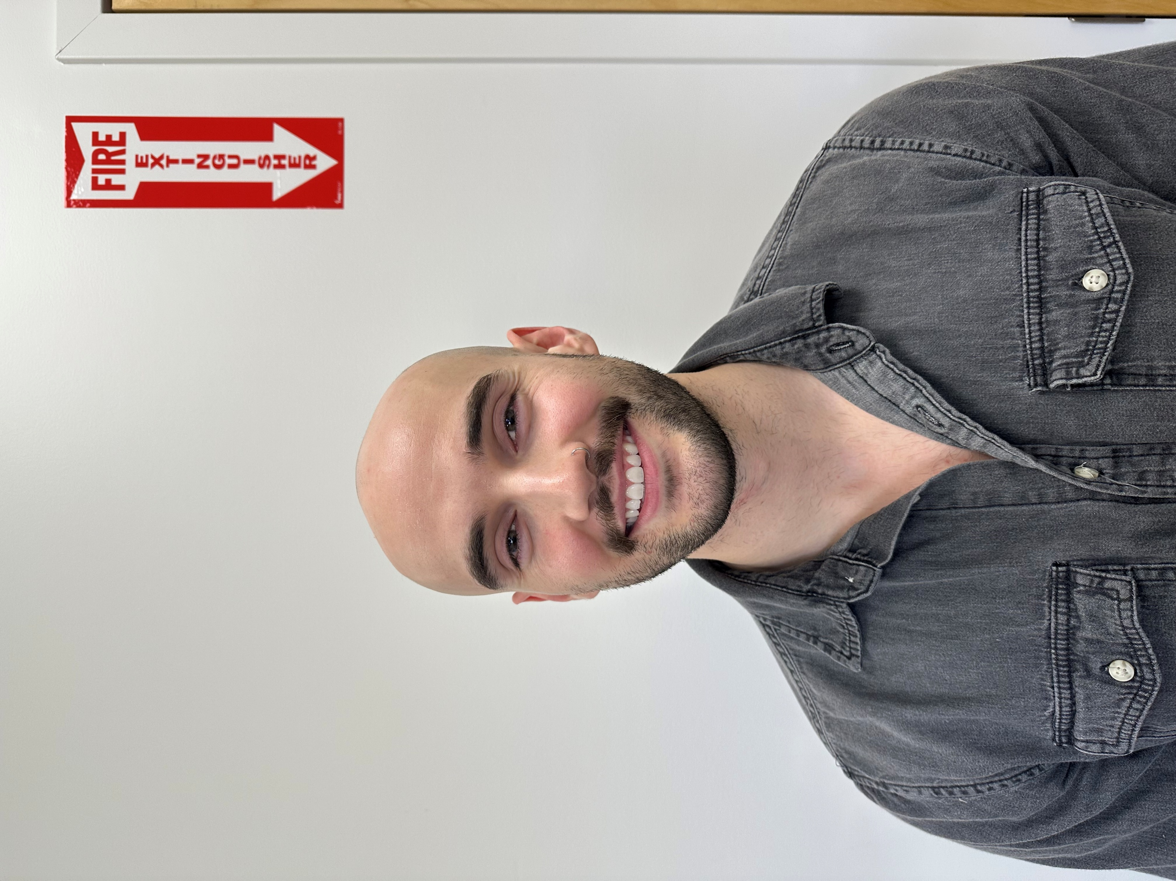
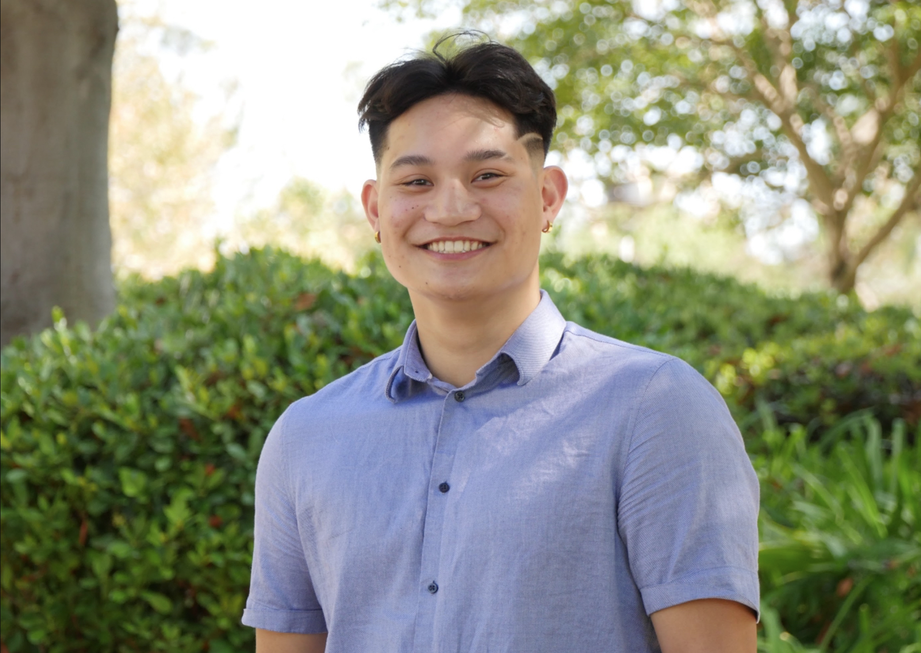
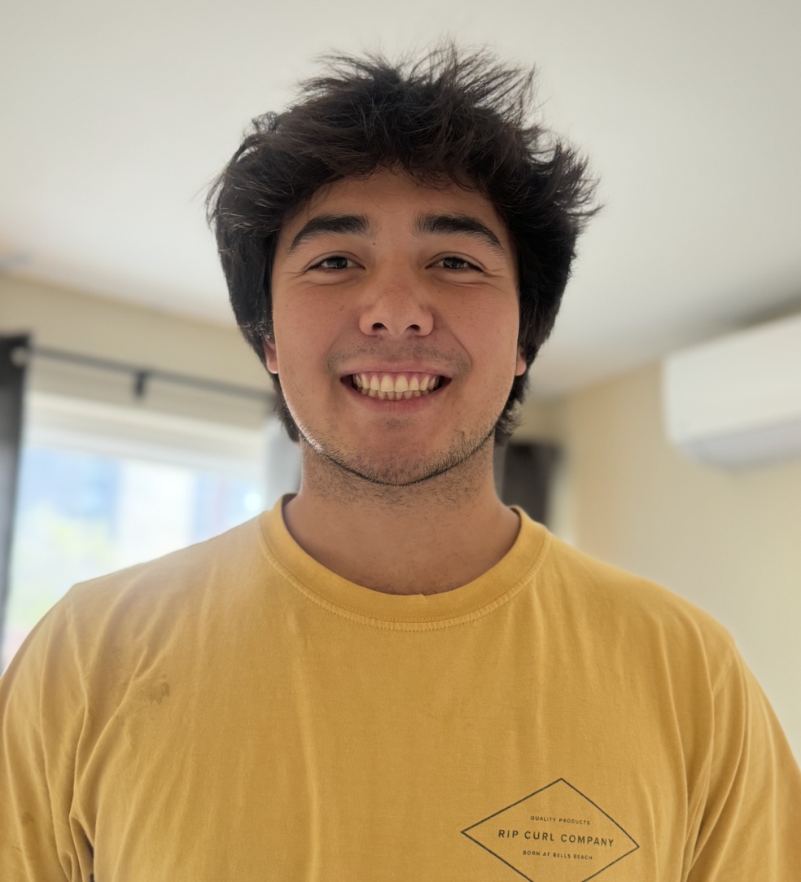
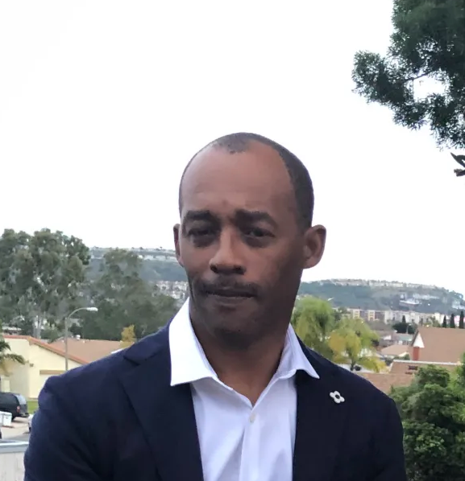
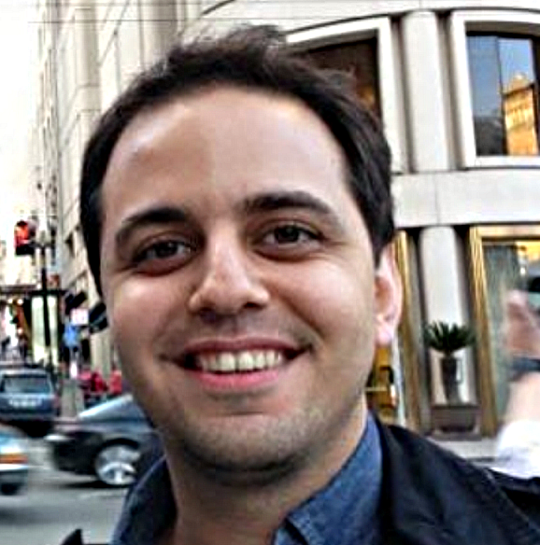
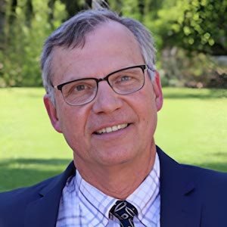
sEMG Hand Movement Classification System HANDS-EMG
Project Overview
Block Diagram
PCB Design
The HANDS-EMG Team, in conjunction with the SDSU Smart Biomedical Systems Laboratory, has developed a portable surface electromyography (sEMG) system designed to classify hand movements using machine learning. The device captures muscle activity signals from the user’s forearm and interprets them in real time through a trained TinyML model running on an STM32 microcontroller. The system uses custom signal processing in MATLAB and Python to train the model, which is then converted into TensorFlow Lite for embedded deployment. This tool is battery-powered, non-invasive, and intended to support applications in prosthetics and rehabilitation by enabling accurate and efficient hand movement recognition.
sEMG Biopotential Signals
The System In Action
Machine Learning Design
Challenges:
In the human body, muscles are controlled by weak EMG signals. EMG signals are voltages generated by the muscle fiber electrical activity. Though surface measurements of these signals are less invasive for the patient, they present uniquely difficult issues for signal integrity and noise robustness in measurement. Additionally, human skin presents unique issues in shifting both signal strength, and impedance between signal source and electrode over time.
TinyML Embedded Statistics
For 3 Gesture Classification
Movements Classified
Live sEMG Data from the 4 Channels (when performing wrist flexion)
Acknowledgements
The Team
Team HANDS-EMG would like to sincerely thank the Andrew Y.J. Szeto Rehabilitation Engineering and Assistive Technology Endowment Fund for sponsoring our project and generously providing the funding in support of our work.
We are also grateful to Dr. Töreyin and Professor Dorr for their guidance and assistance throughout the project.
Special thanks to Mr. Mark Bruno for his support with hardware design and troubleshooting, which was instrumental to our progress.
Blake Pearson Computer Engineer
Noah Marosok Computer Engineer
Jayden Sumbillo Electrical Engineer
Kelly Hubbard Electrical Engineer
Kirk Young Electrical Engineer
Dr. Hakan Töreyin PI & Advisor
Prof. Barry Dorr
Advisor
SPRING 2025

